Slide 1
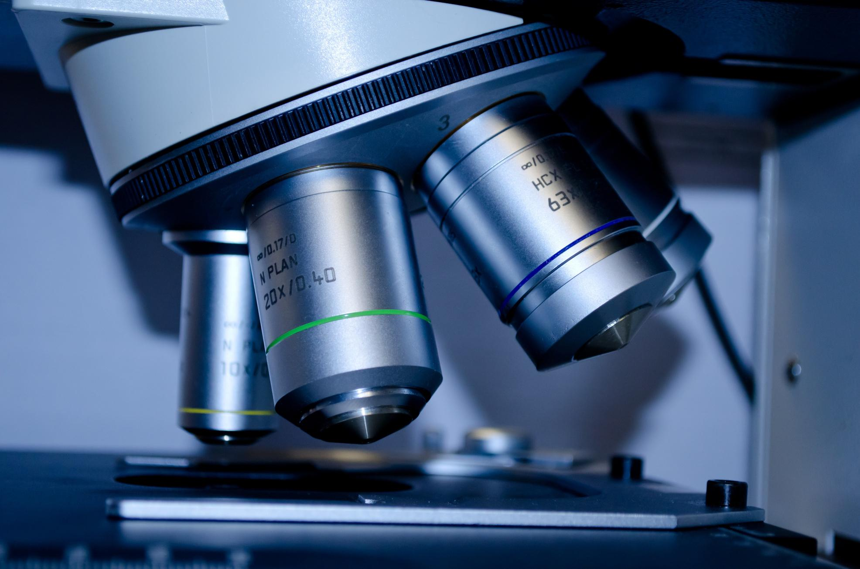
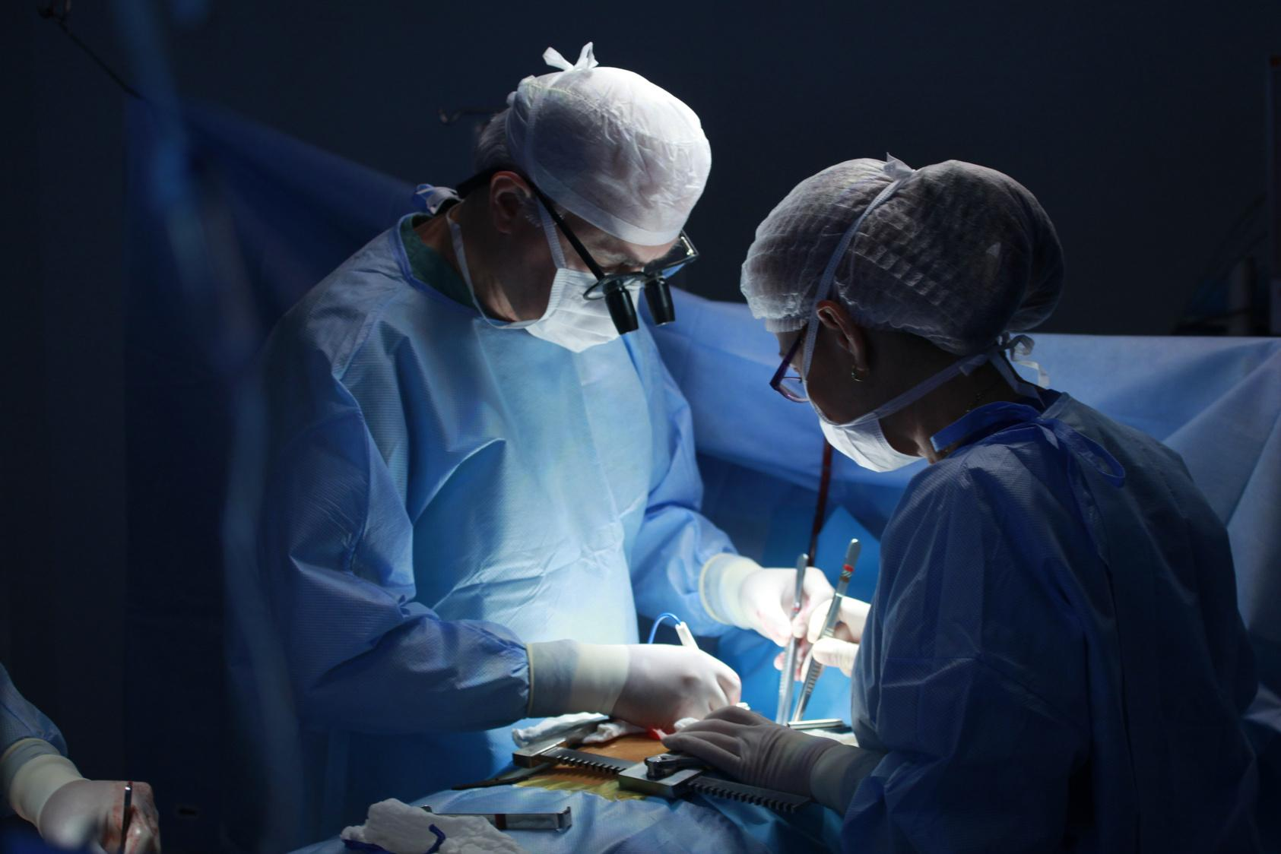
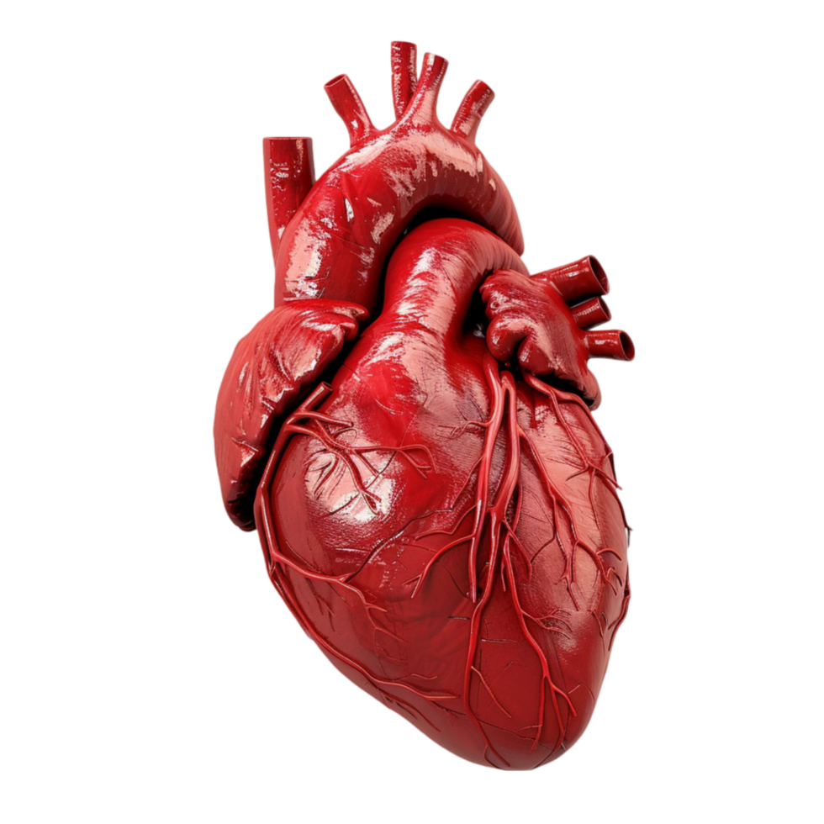
By: Myroslav Protsiv, Caleb Allen, Ling Bramlett, Belay Hagos
Healthcare
Industry
for Identifying Heart Disease

Slide 2
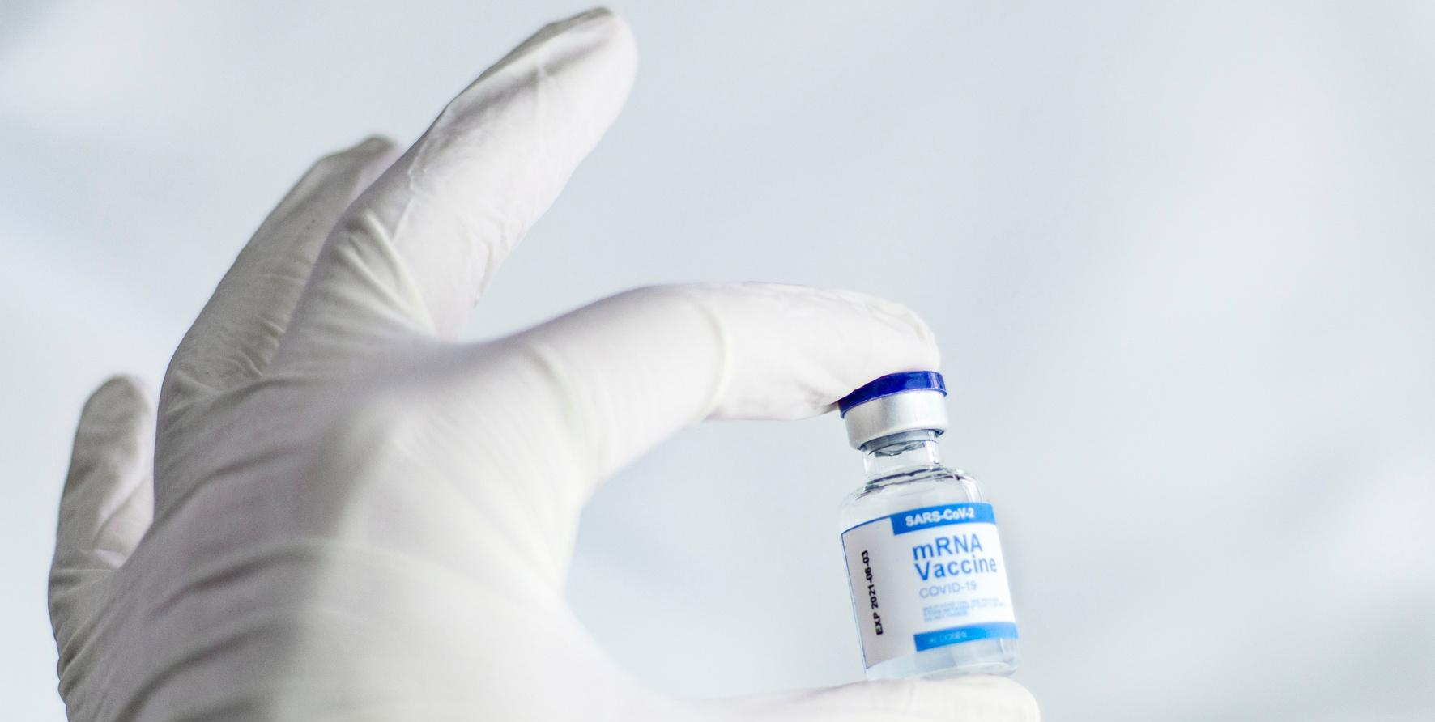
PURPOSE
The Project is focused on the healthcare industry for identifying heart disease.
Our team emphasizes achieving a model performance with a recall value exceeding 75%. Because high recall is the most important in a medical context, if there is a missing patient with a potential heart disease there could be serious consequences.
Our group focused on the following model techniques:
Why Make this?
-Developing models to predict likelihood of patients with
chronic heart disease can help early treatment.
- Can discover common factors that give you a higher chance of chronic heart disease.
- Can prevent deaths in people who are at risk of heart disease or unknowingly have it.

Slide 3

01.
We use the data to train and run the test of the data set.
How Does it Work?
The “x” feature is standardized using standard scaler. The “x” and “y” trained the feature are fitted.
02.
03.
The “x” train and “x” test are transformed

Slide 4

1. K-Nearest Neighbors (KNN)
2. Support Vector Machine (SVM)
3. Random Forest
4. Decision Tree
5. Logistic Regression
6. Neutral Network
.
- The model has been defined
- A grid search with cross-validation
has been conducted
The best parameter and score has been printed
Additionally, the classification
report has been printed for assessment.
Modeling Techniques

Slide 5
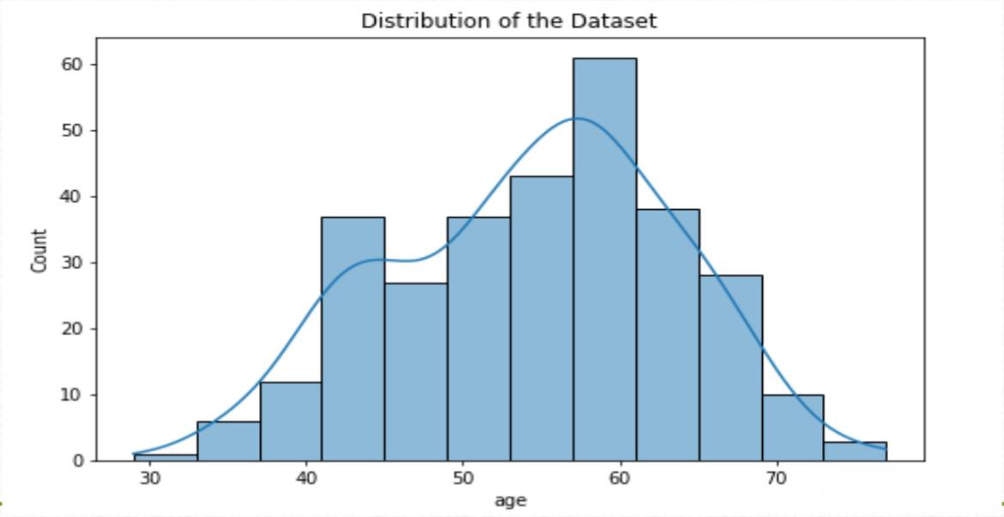
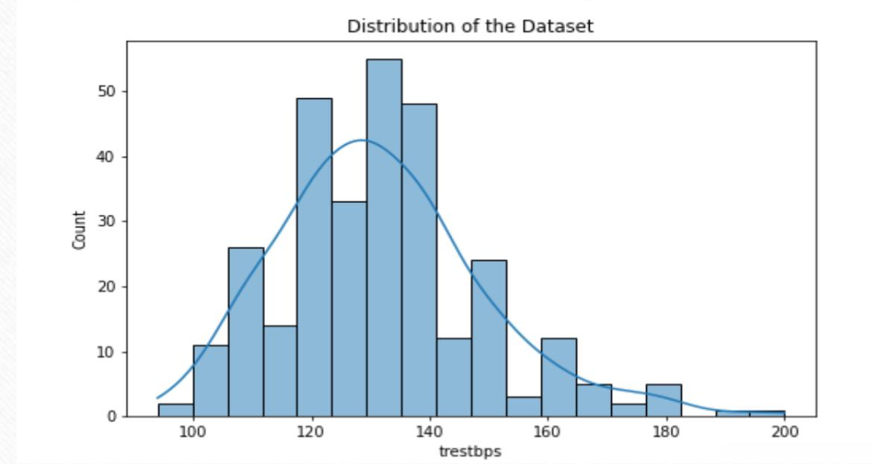
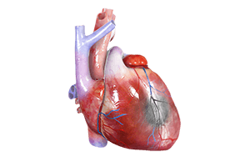
Data
Visualization
Here are the charts to show the distribution of the data set

Slide 6
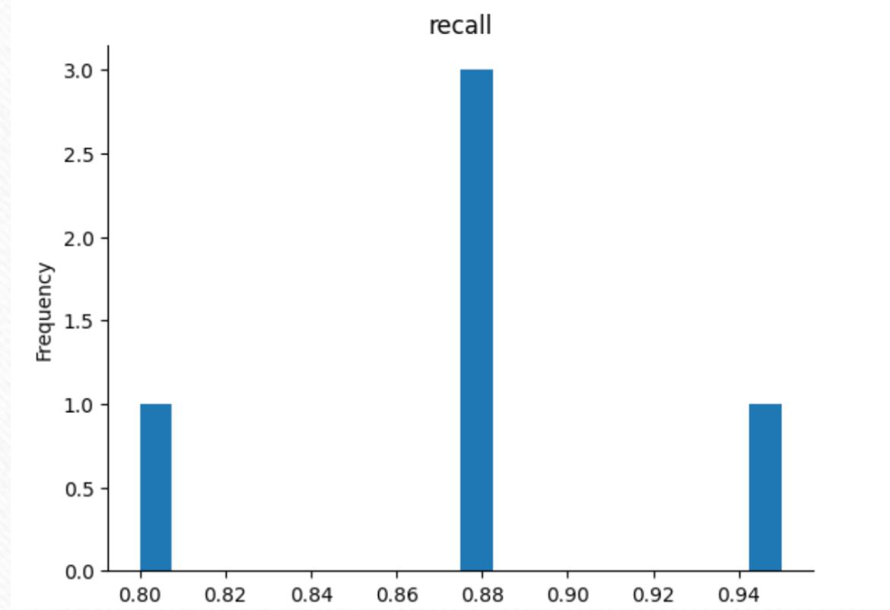

Support Vector
Machine (SVM) Recall Value
Large recall as the amount is 95%

Slide 7
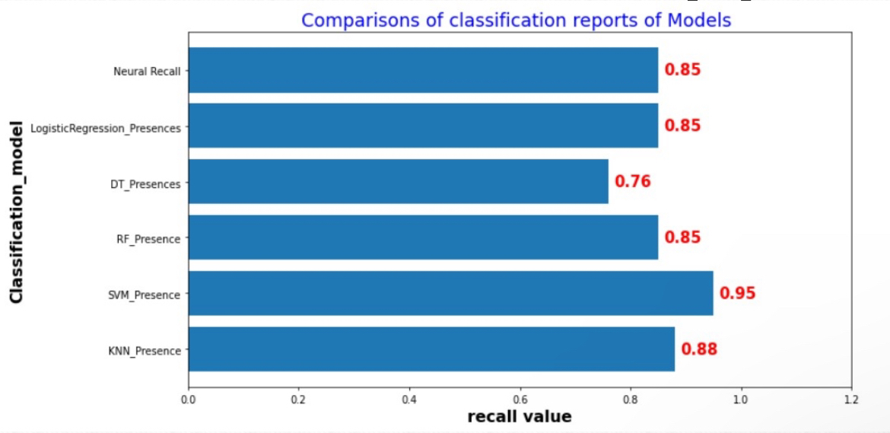
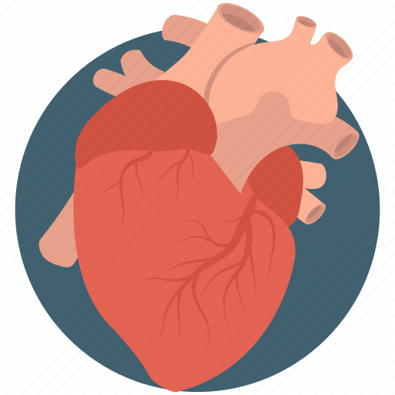
Comparisons of the
Classification
Out of all 6 of the modelings made the vector support did the best with a recall of 95%!

Slide 8
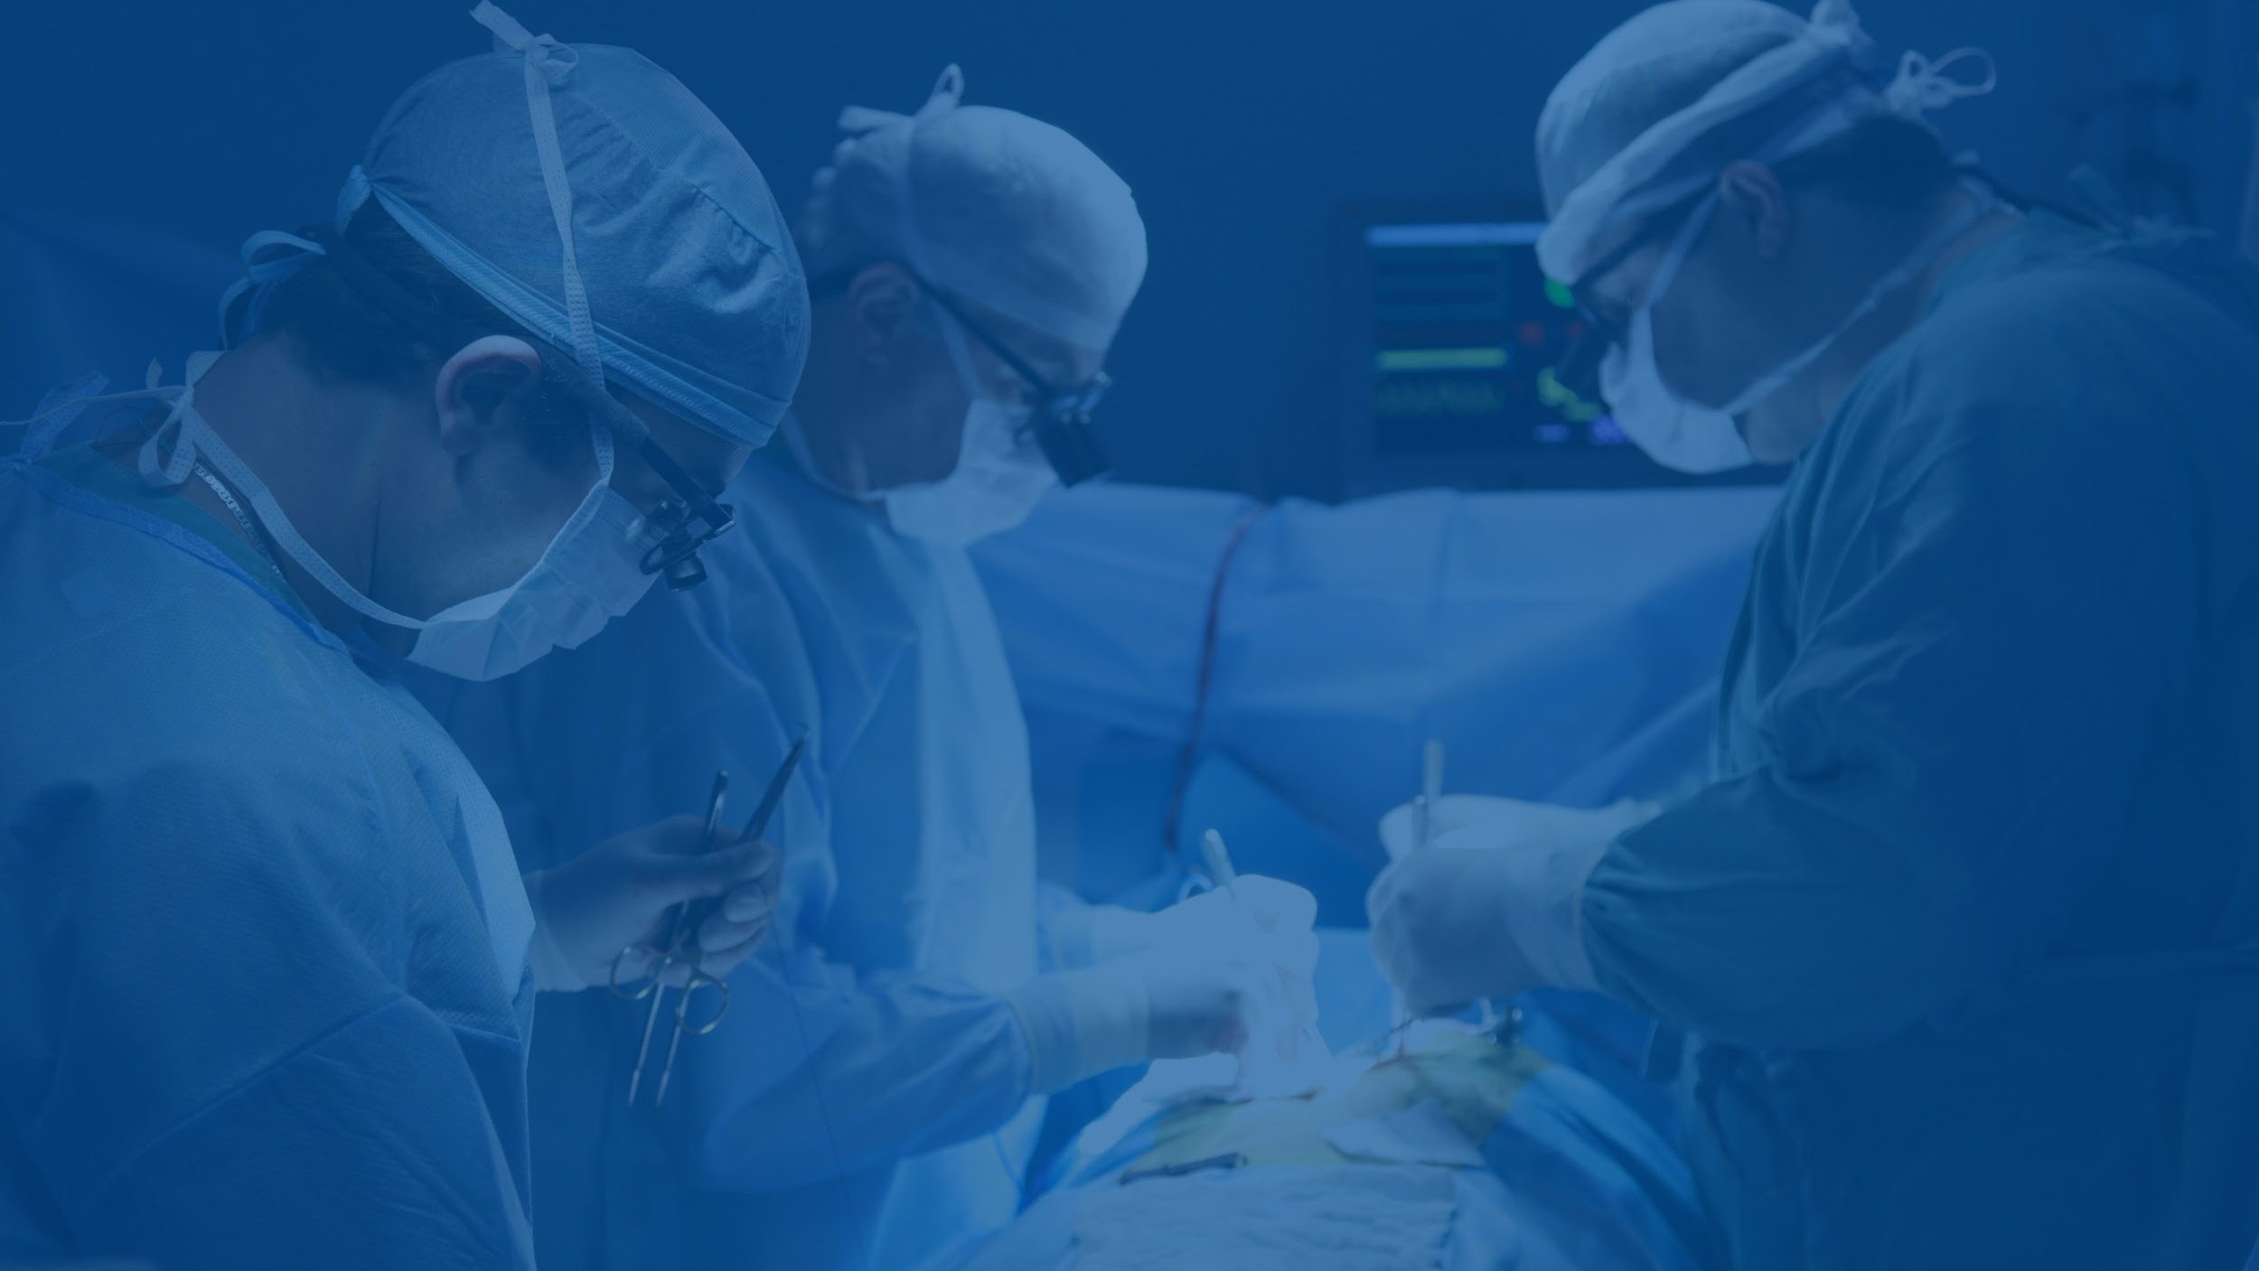
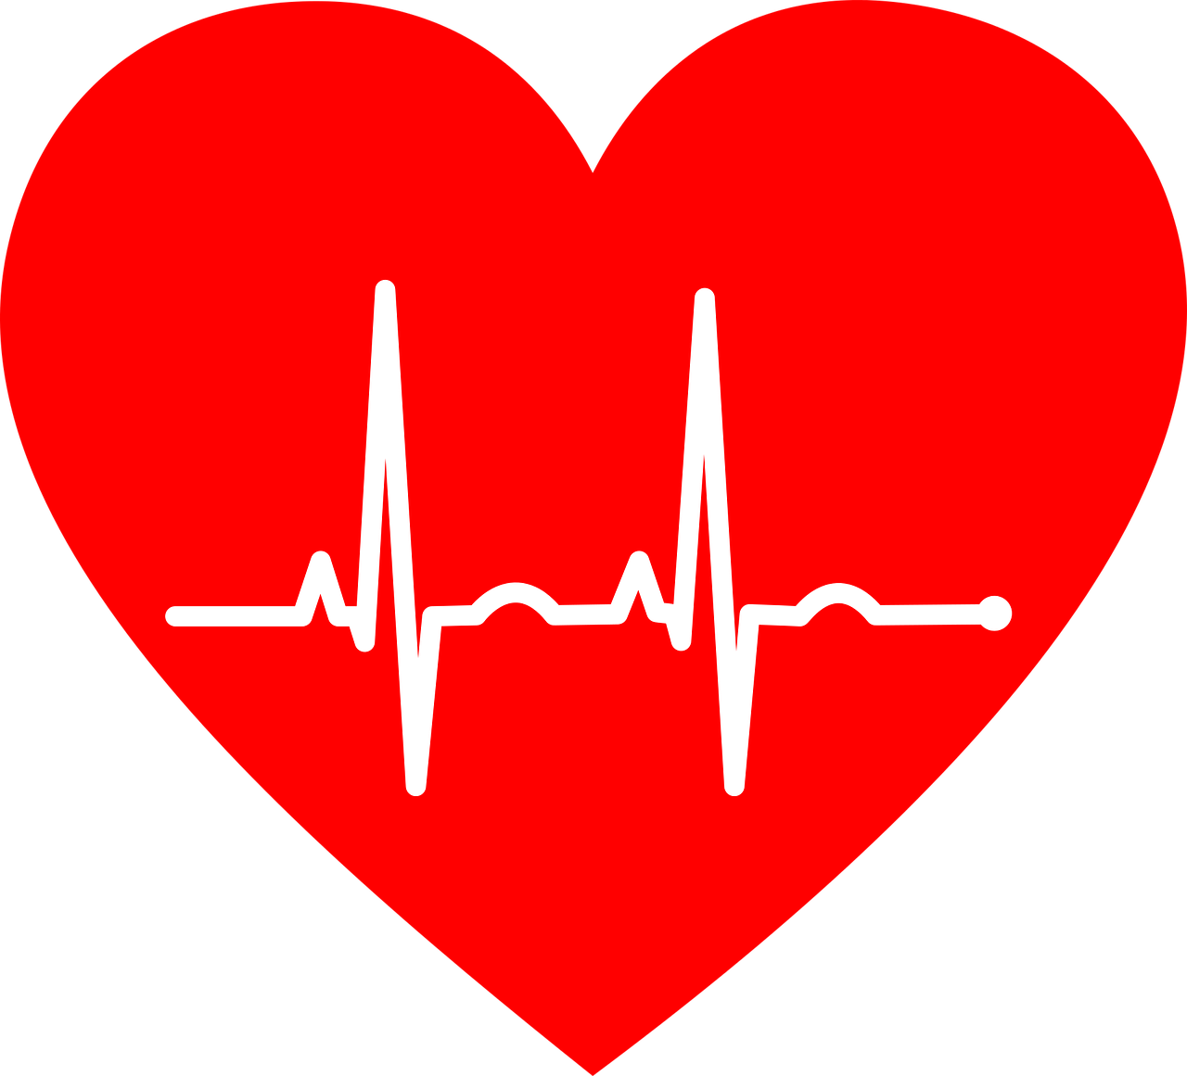
=.
Conclusion
Based on the results on the recall value, our team recommended using the support vector for any sign of heart disease. With a recall value of 95% this will allow for early intervention for treatment.

Slide 9
Thank you!

